Slide 1
Research Week 10
Xiaoshu Luo

Slide 2
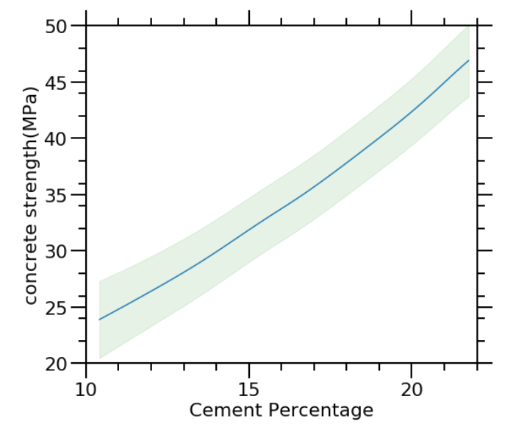
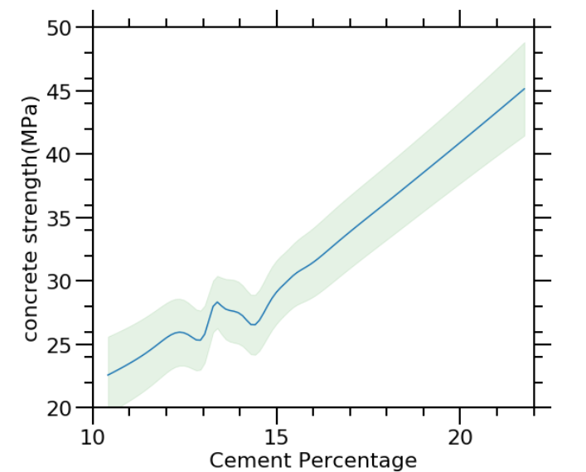
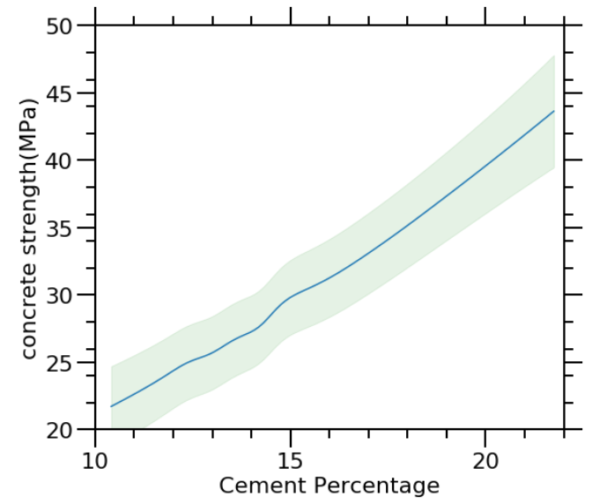
25% quantile median 75% quantile
For the Gpy package
7-Day concrete strength tested by one predictor and setting all the others as constant

Slide 3
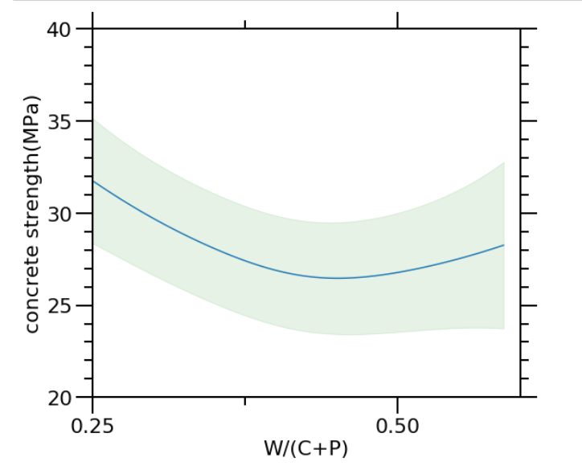
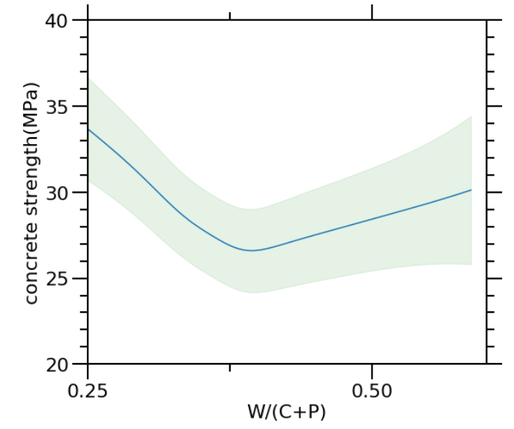
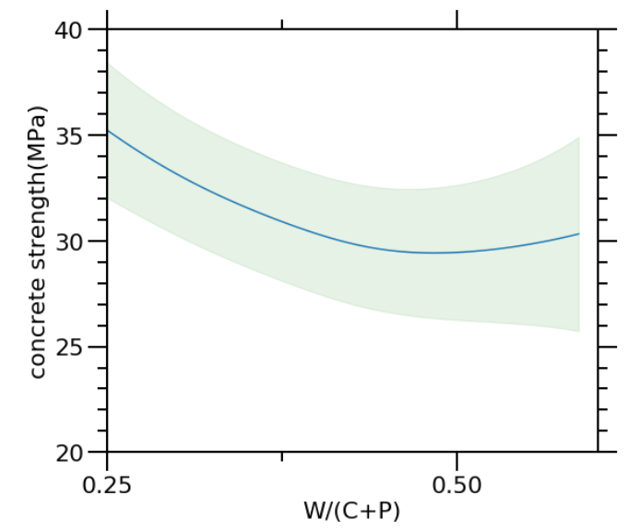
25% quantile median 75% quantile
For the Gpy package
7-Day concrete strength tested by one predictor

Slide 4
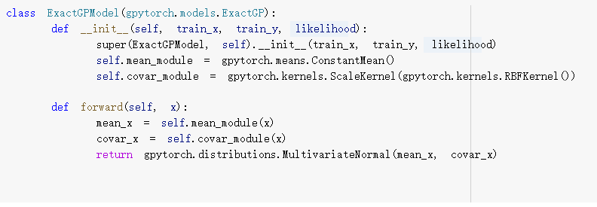
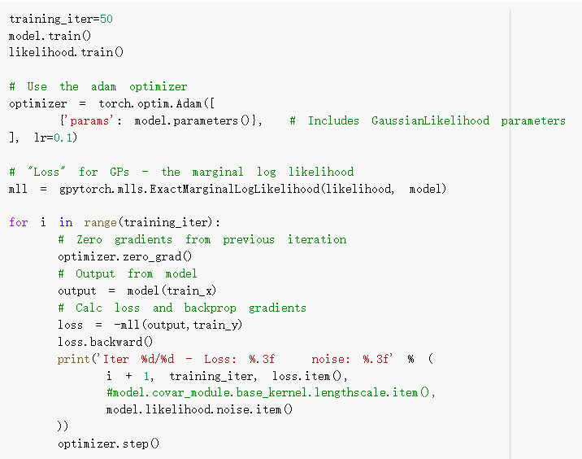

Using the new Gpytorch package

Slide 5
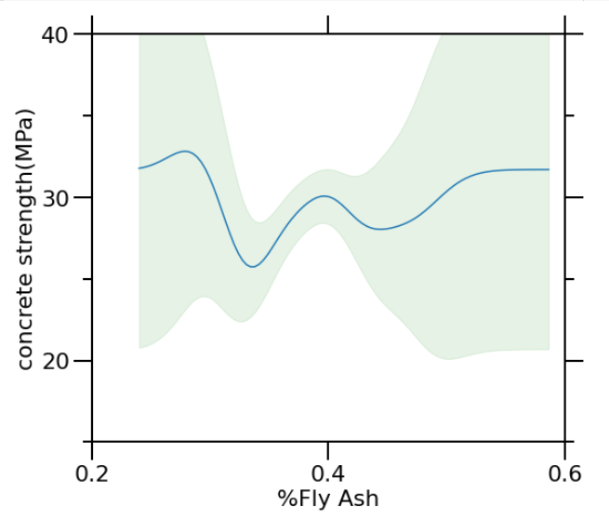
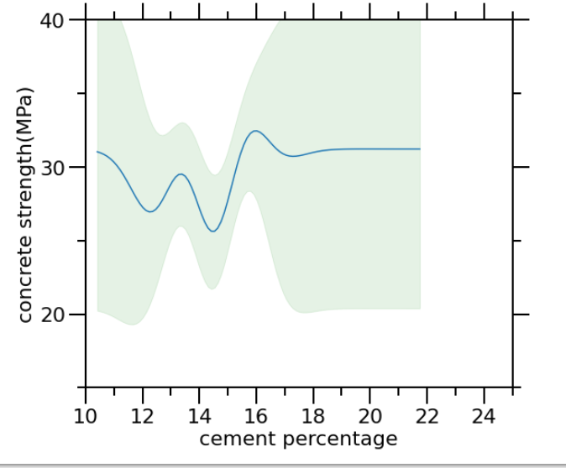
W/(C+P)

Slide 6


